Slide 2
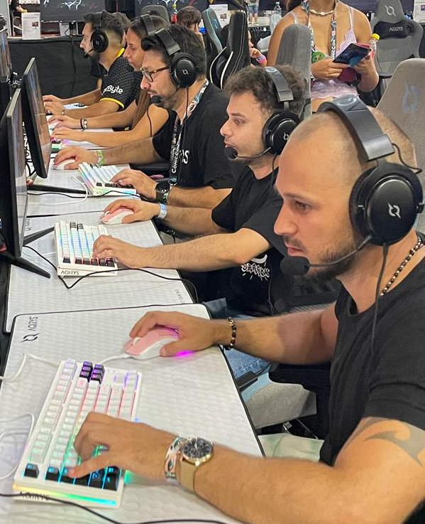
Who is AQIRYS
As stated by our motto, "All About Gaming," AQIRYS is about IT products dedicated to gaming. Our solutions focus on variety, quality, and affordability, being developed, customized, and fine-tuned in Europe by a passionate team with over 17 years of expertise in the IT & gaming industry.
We strive to offer these products to people passionate about gaming within a dynamic environment and with a cool voice, making them feel satisfied and recognized.

Slide 3
Our Attributes
CULTURE
How are we perceived by the target audience
CLIENT
Attributes of the ideal customer
VOICE
How customers perceive our voice
FEELING
How the customer feels after interacting with us
THE IMPACT
The benefit we deliver to the customer
X FACTOR
What makes us special
Dynamic
Gamer
Cool
Satisfied
Recognition
In trend

Slide 4
Visual projection of our attributes
Friendly
Professional
Simple
Sophisticated
Male
Female
Economic
Luxuriant
Modern
Traditional

Slide 5
AQIRYS – Why and How?
Why?
The values promoted by the AQIRYS brand are passion for gaming, dynamism, adaptability, and innovation.
What?
Quality products, with modern and innovative design, at a fair price.
How?
We communicate our product qualities transparently and in smart ways, using modern messages and a cool, professional voice.

Slide 6
AQIRYS – Why and How?
Why?
QUALITY DYNAMISM DIVERSITY
AQIRYS PROMISE
COOL
SATISFIED
RECOGNIZED
EMOTIONAL
BENEFITS
QUALITY
FAIR PRICE
AQIRYS offers qualitative and durable products
AQIRYS offers impressive products with an attractive appearance at affordable prices
FUNCTIONAL
BENEFITS
X FACTOR – WHAT MAKES AQIRYS
SPECIAL & DIFFERENT
COOL, IN TREND
DESIGN & QUALITY
Those who interact with AQIRYS, feel they are part of a community that’s not only cool but also aware of the trends in the gaming world
Quality products
with modern design
What?

Slide 7
AQIRYS – Why and How?
FAIR PRICE
LATEST HARDWARE
PACKAGING
UNBOXING
A unique unboxing experience offered by the accessories delivered with each product
Premium products with attractive appearance at a fair price
Rapid adoption of new technologies available in the field
Premium products in premium packaging
New Hardware
Premium boxes
Satisfied
Competitive

Slide 8
Our Target
Gamer enthusiasts
People who are passionate about video games and spend a lot of time in perfecting their gaming strategies and moving up the ladder of the most popular games. best players.
Casual gamers
People who use video games as a method of spending
leisure time or as a method of reward and wish to have quality objects with attractive design.
Focus
People who appreciate trendy products
Consumers of popular, cool, trendy, stylish goods design.

Slide 9
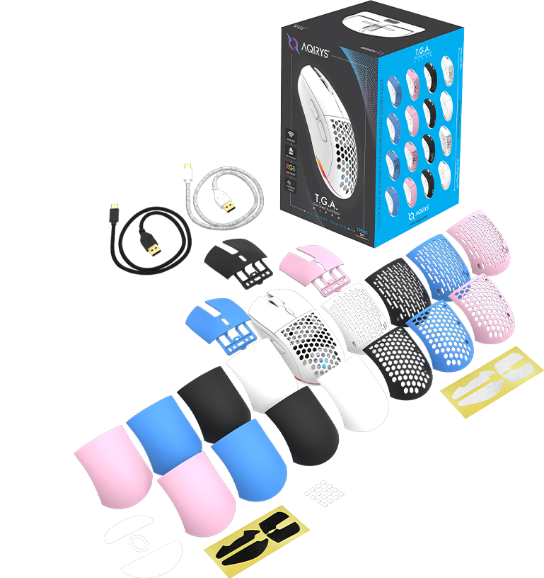
Our Offer
Complete AQIRYS gaming ecosystem consisting of mice, keyboards, headsets, mousepads, microphones, chairs, PC cases, CPU coolers, and PSUs.
Flagship products with A-brand characteristics at a more competitive price
Early access to the latest technologies
Premium retail packaging for all the products
Surprise gifts and extra accessories included in the standard box for a richer unboxing experience
Quality products fine-tuned in Europe for the western market

Slide 10
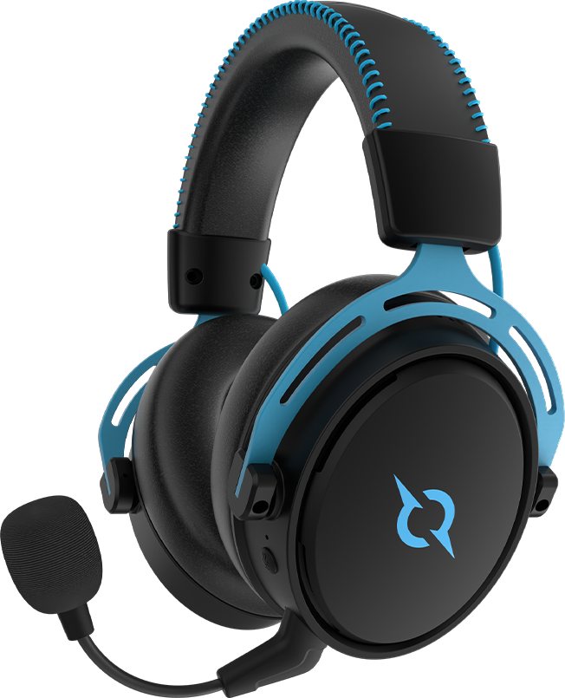
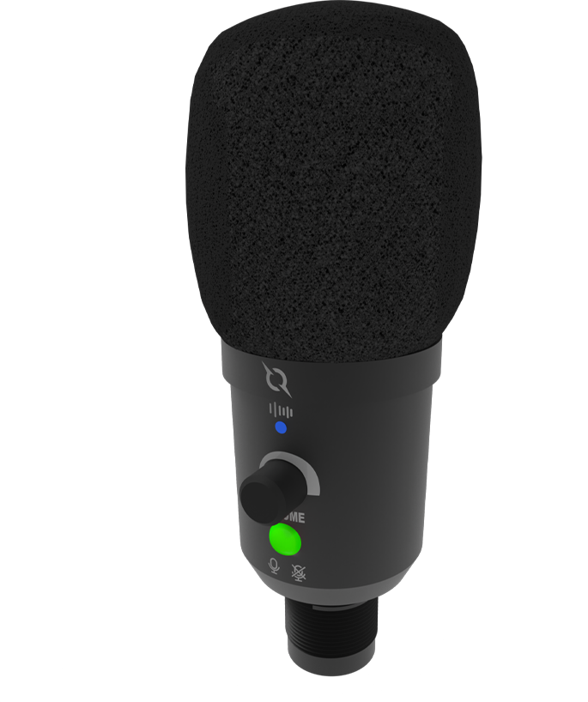
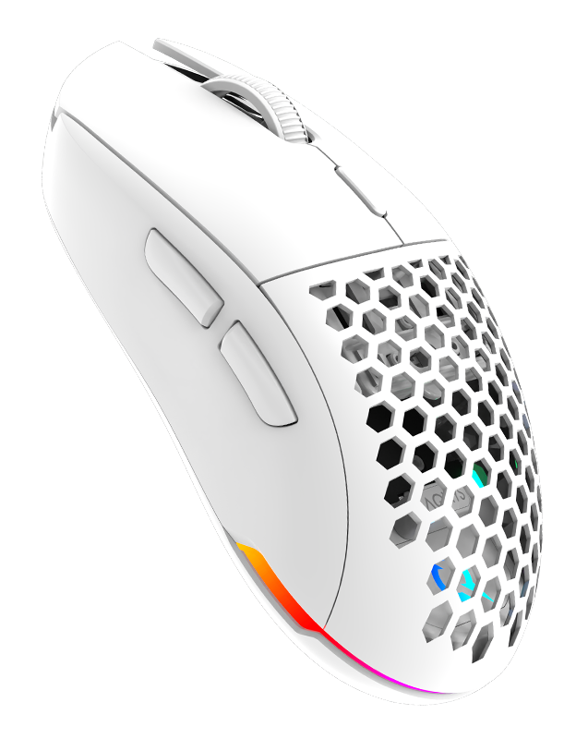
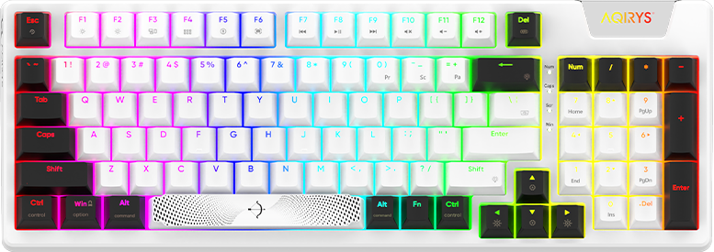
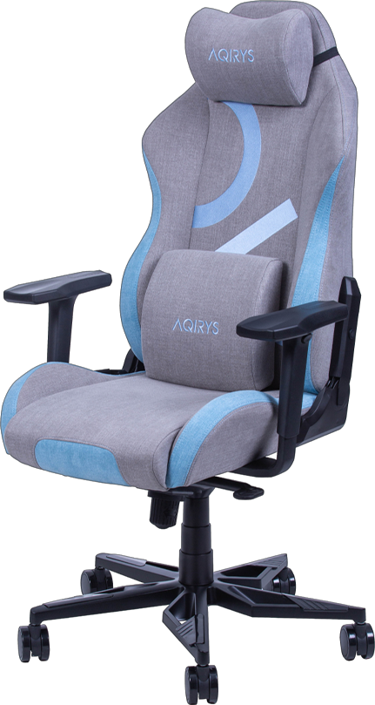
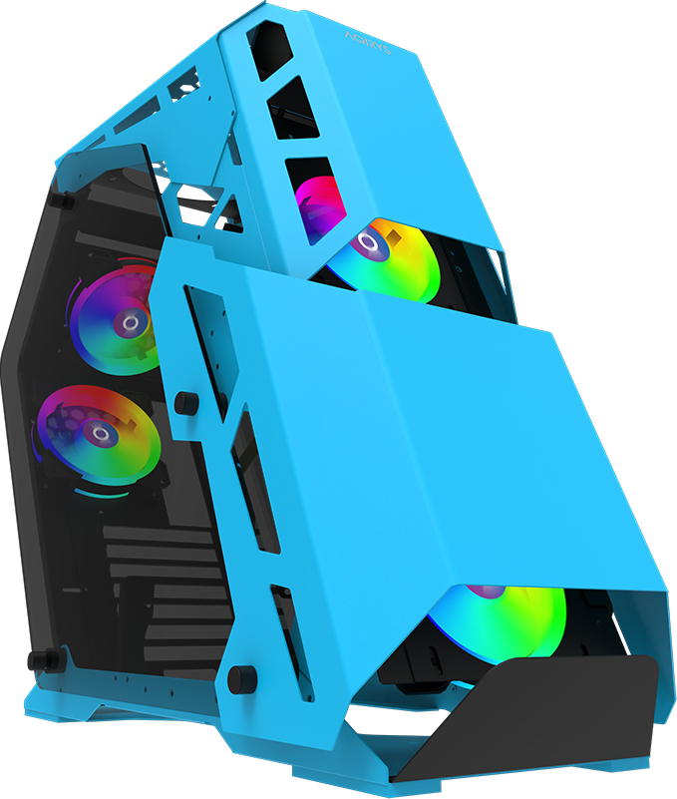
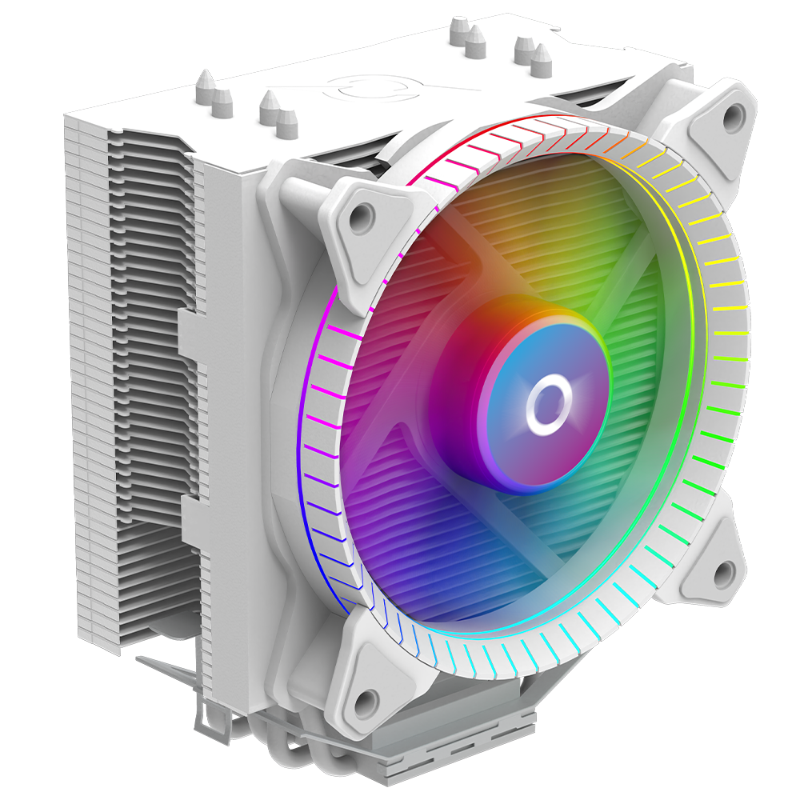
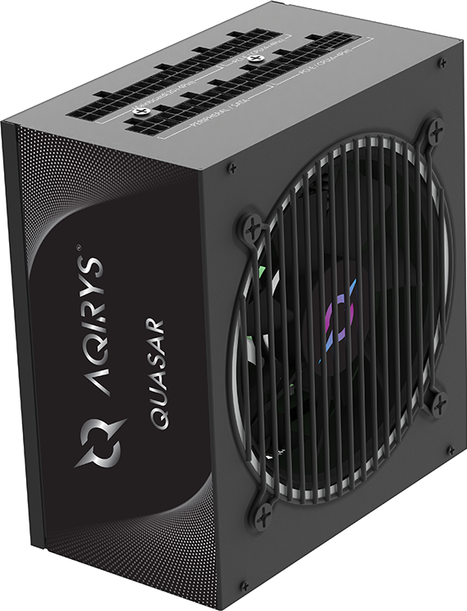
AQIRYS gaming ecosystem
Mouse
Keyboard
Headset
Microphone
Gaming Chair
PC Case
CPU Cooler
PSU

Slide 11
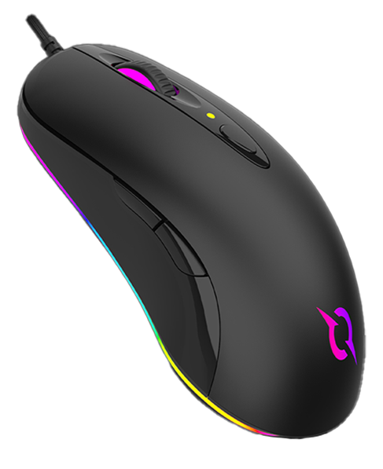
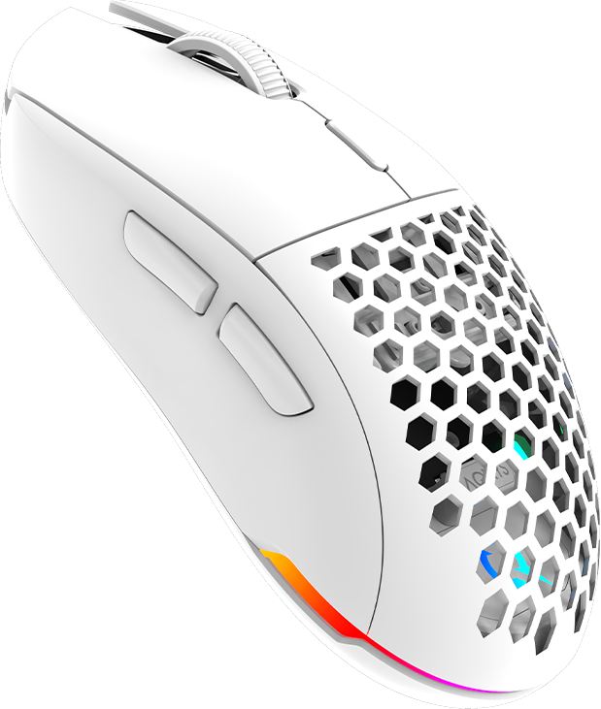
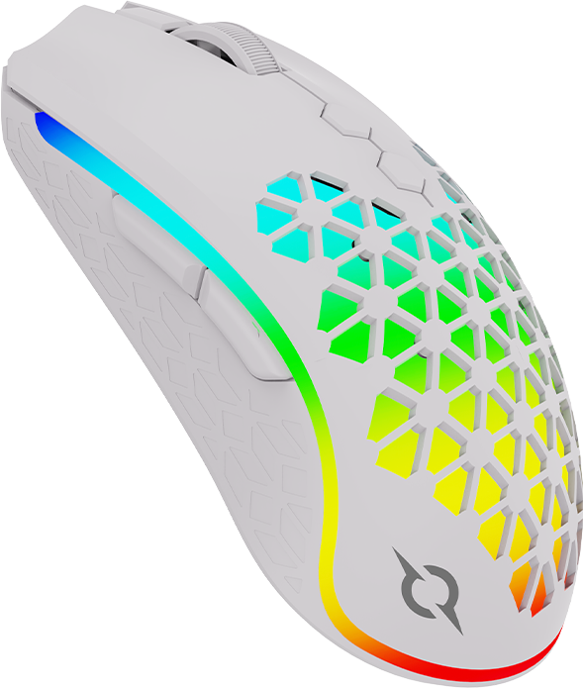
AQIRYS - Mice

Slide 12
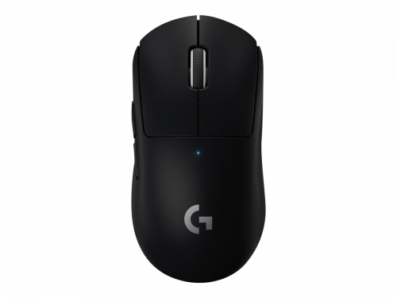
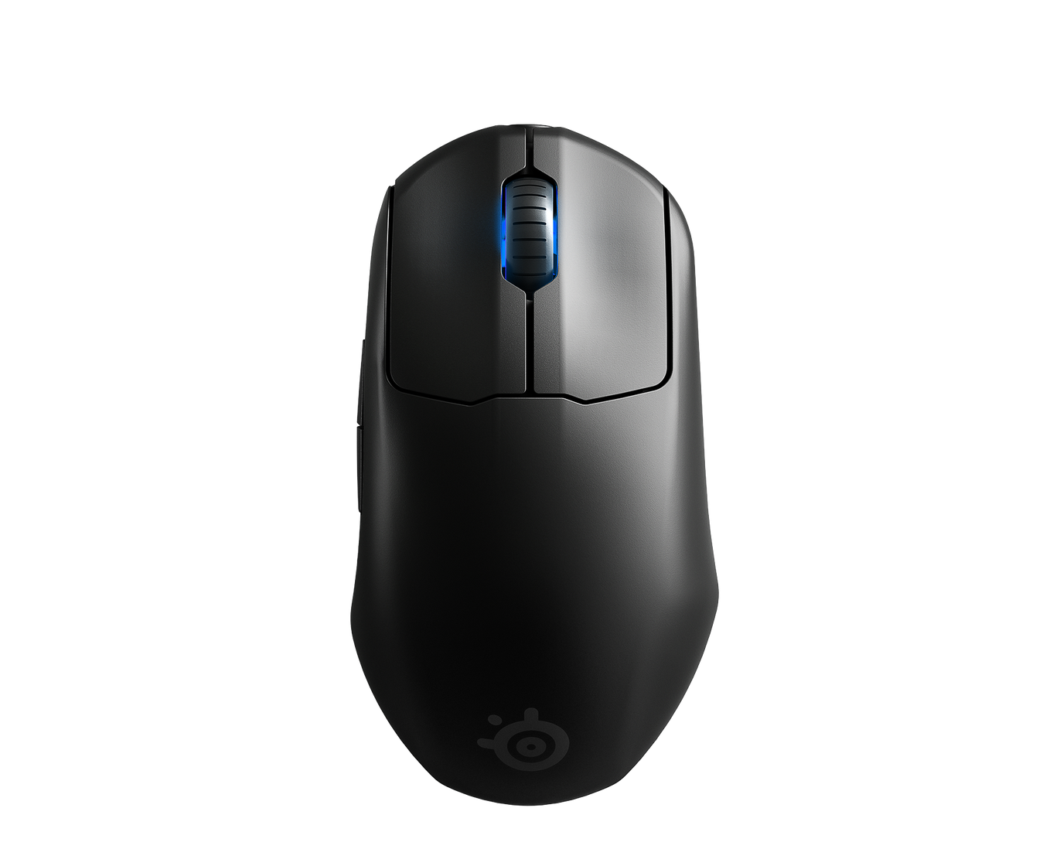
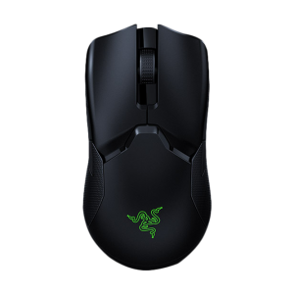
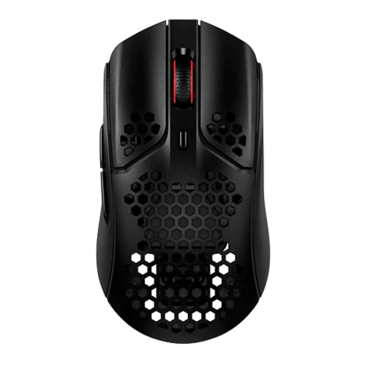
AQIRYS – Wireless Mice
AQIRYS T.G.A. Alpha
LOGITECH G Pro X Superlight
SteelSeries PRIME Wireless
RAZER Viper Ultimate
HyperX Pulse fire Haste
MSRP
89.99 €
159.99 €
139.99 €
149.99 €
79.99 €
Weight
65g
63g
80g
74g
59g
Sensor
PixArt 3370
HERO™
TrueMove Air
Optical Razer
PixArt 3355
Switch Type
Kailh 80M
Omron 20M White
Prestige OM™ 100M
Optical 70M
TTC Golden 80M
RGB
3 zone
No
1 zone
1 zone
1 zone
Cable
Ultra-light, braided
Rubber Cable
Braided
Razer™ Speedflex
HyperFlex
Extras
- 2x Side Grips, - 20 extra modules for palm and buttons - PTFE feet - 2x USB cable, black & white
- Cloth wipe - PTFE feet
NO
NO
- Cloth wipe - PTFE feet

Slide 13
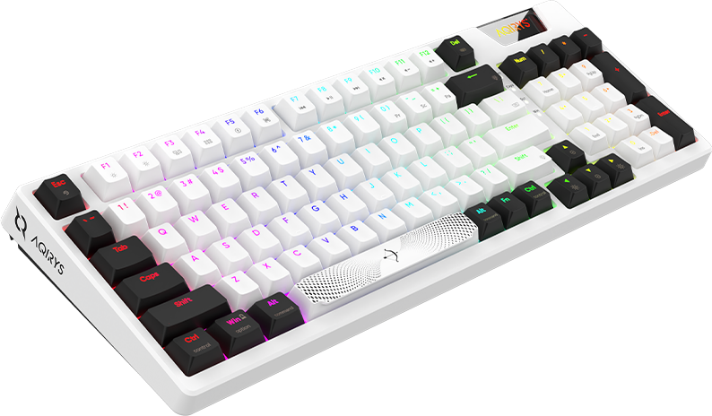
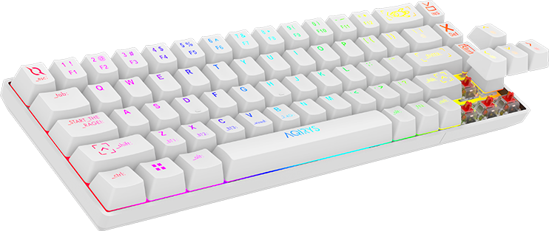
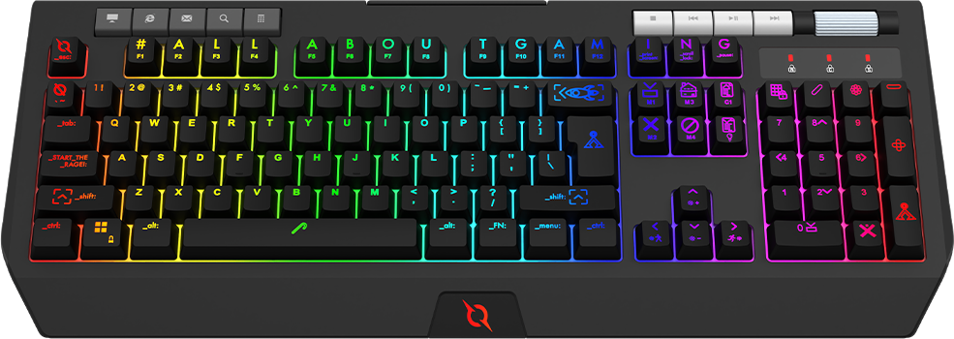
AQIRYS - Keyboards

Slide 14
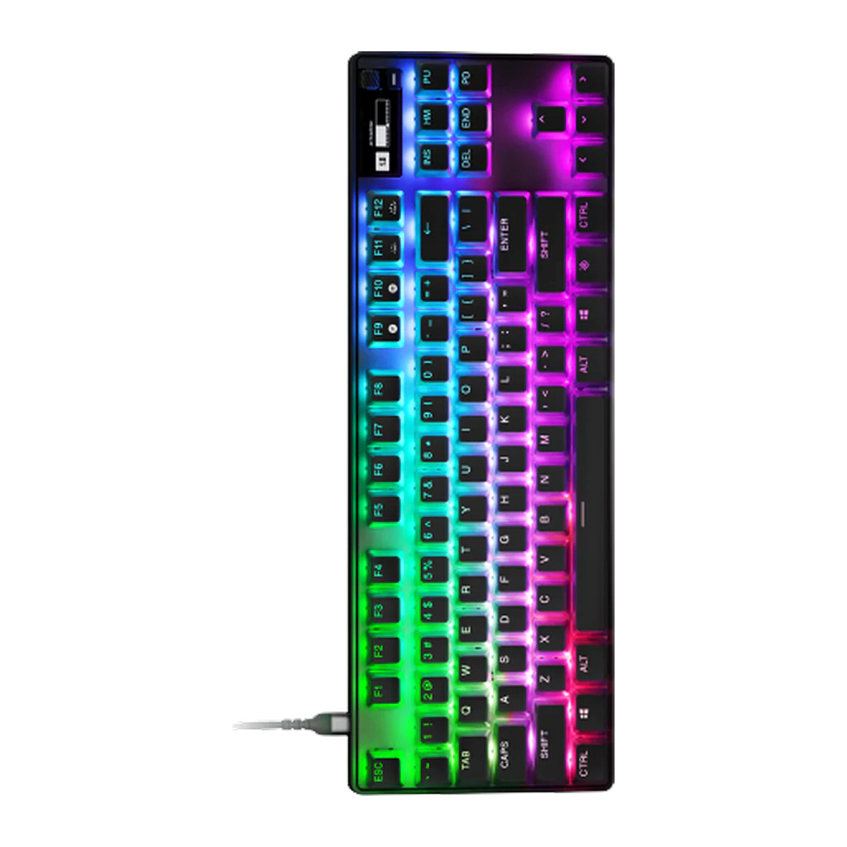
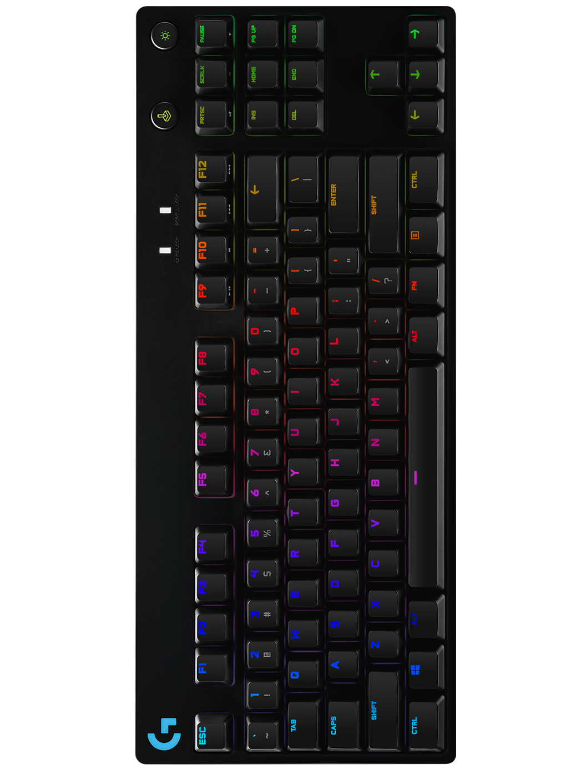
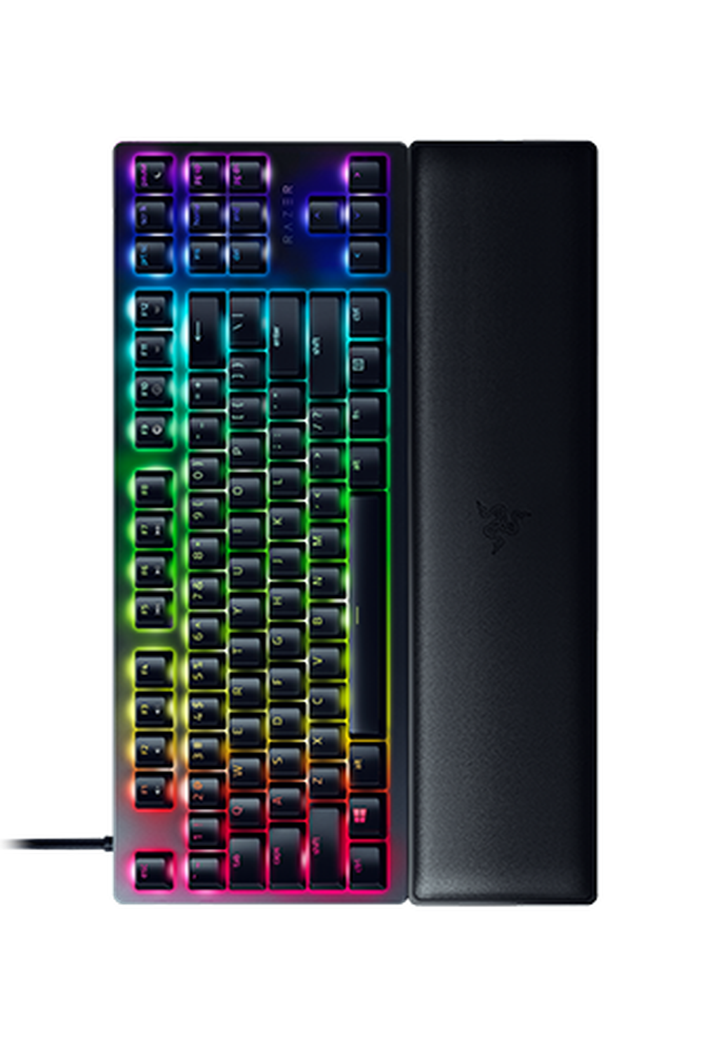
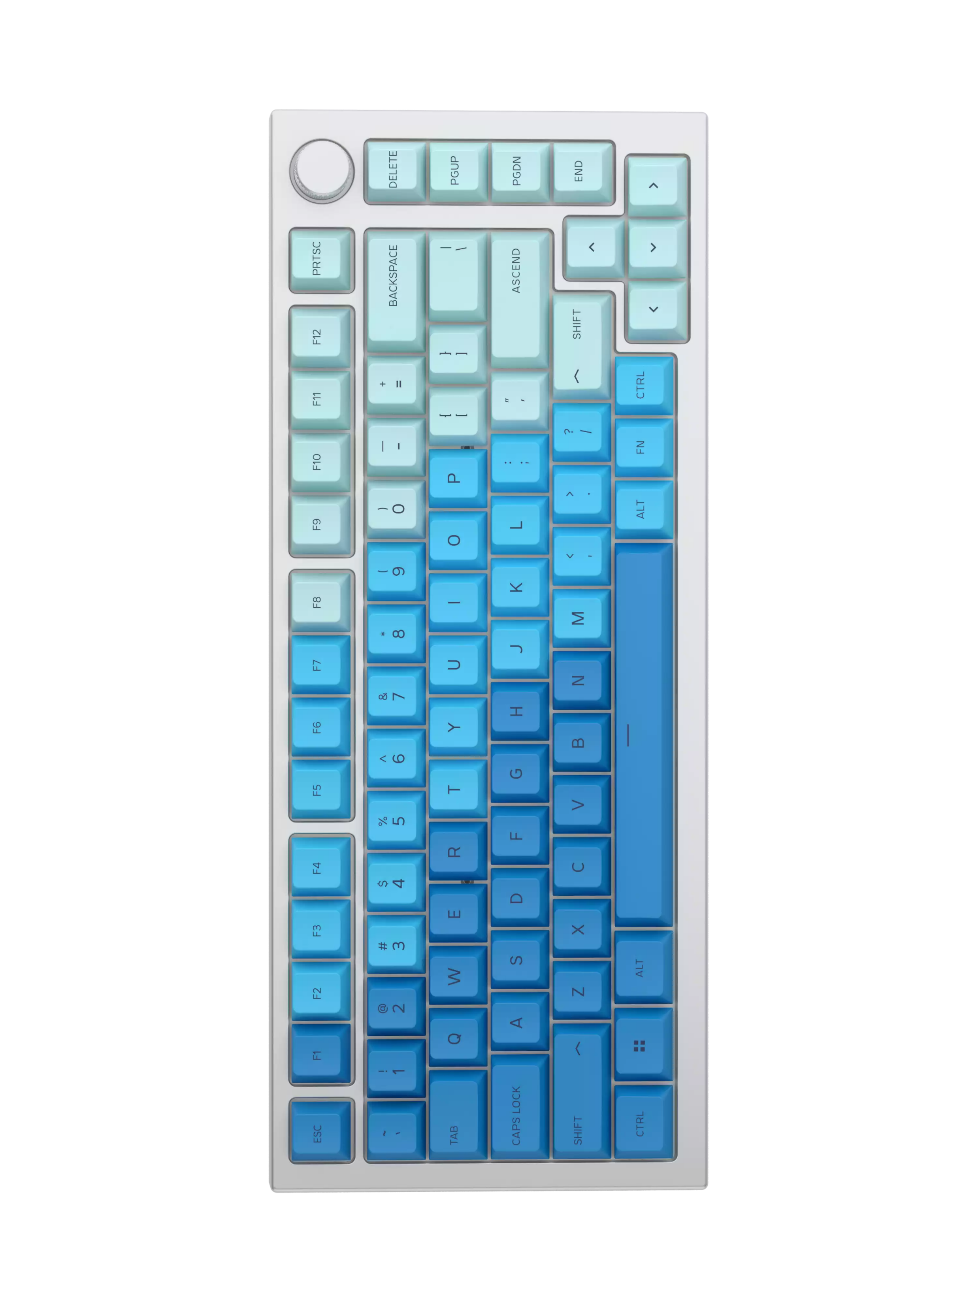
AQIRYS – Mechanical Keyboards
AQIRYS Adara
LOGITECH PRO X
APEX PRO TKL
RAZER Huntsman V2
GLORIOUS GMMK PRO 75% Prebuilt
MSRP
114.99 €
149.99 €
229.99 €
209.99 €
349.99 €
From Factor
1800 Compact
TKL
Full
Full
75%
Pre lube Switch
Yes
No
No
No
Yes
Hot-swappable
Yes
Yes
No
No
Yes
Gasket-Mount
Yes
No
No
No
Yes
PCB silencer
Yes
No
No
Yes
Yes
Keycaps
Backlit Double Shot PBT
OEM profile, Backlit, ABS
Backlit Double Shot PBT
Backlit Double Shot PBT
Double Shot PBT
Extras
- 20 pre-lube Tactile switches - Multitool brush - extra wider space - Aviator style cable
No
No
No
Aviator style cable

Slide 15
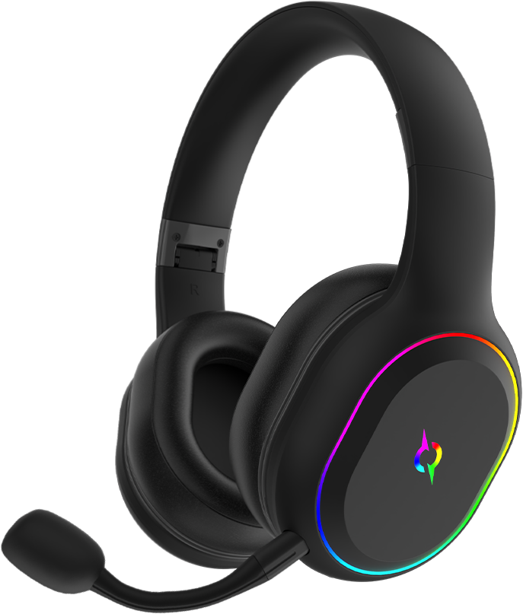
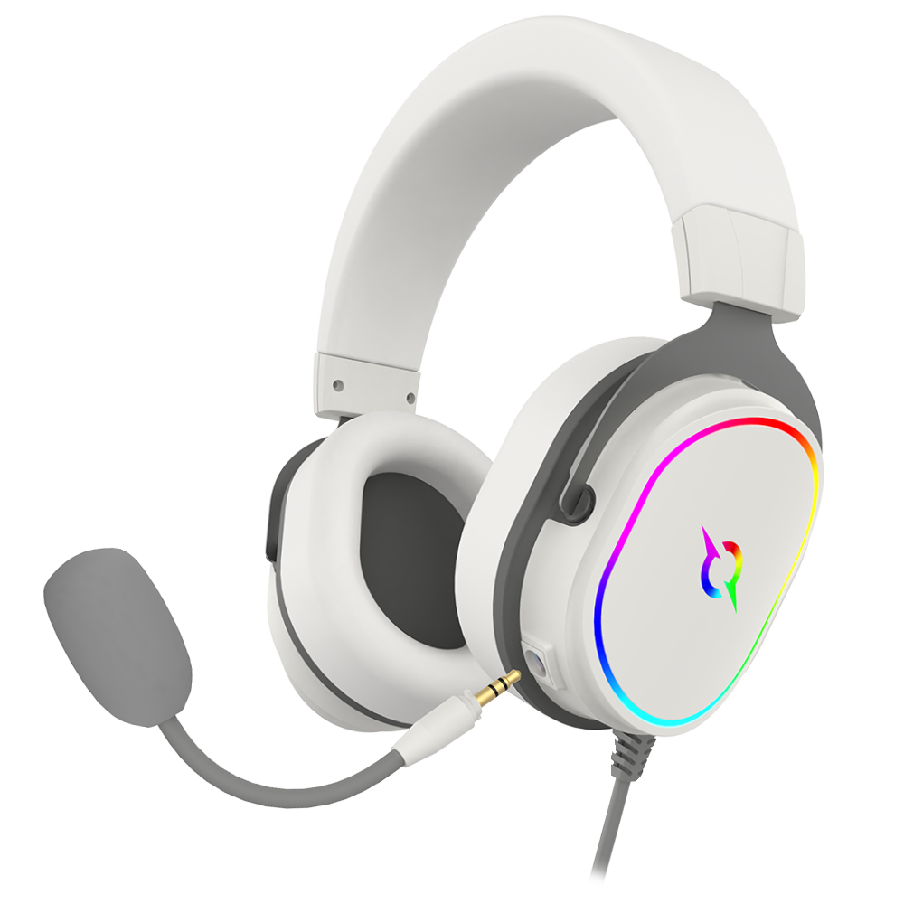
AQIRYS - Headsets

Slide 16
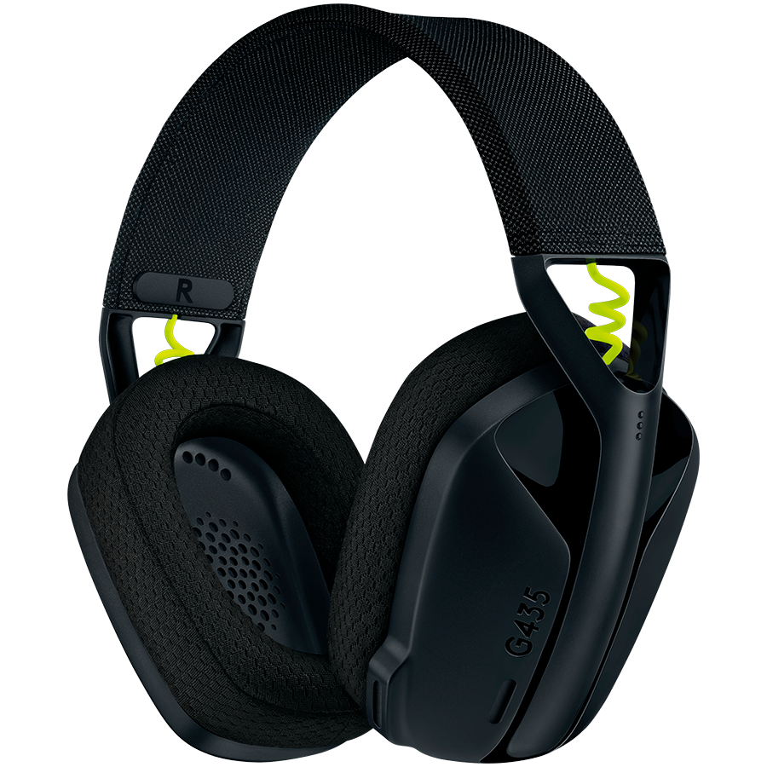
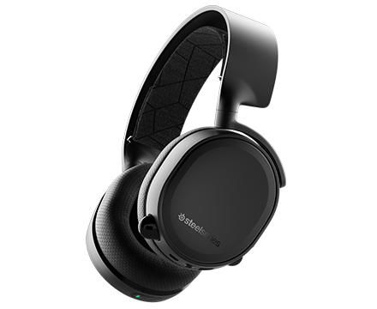
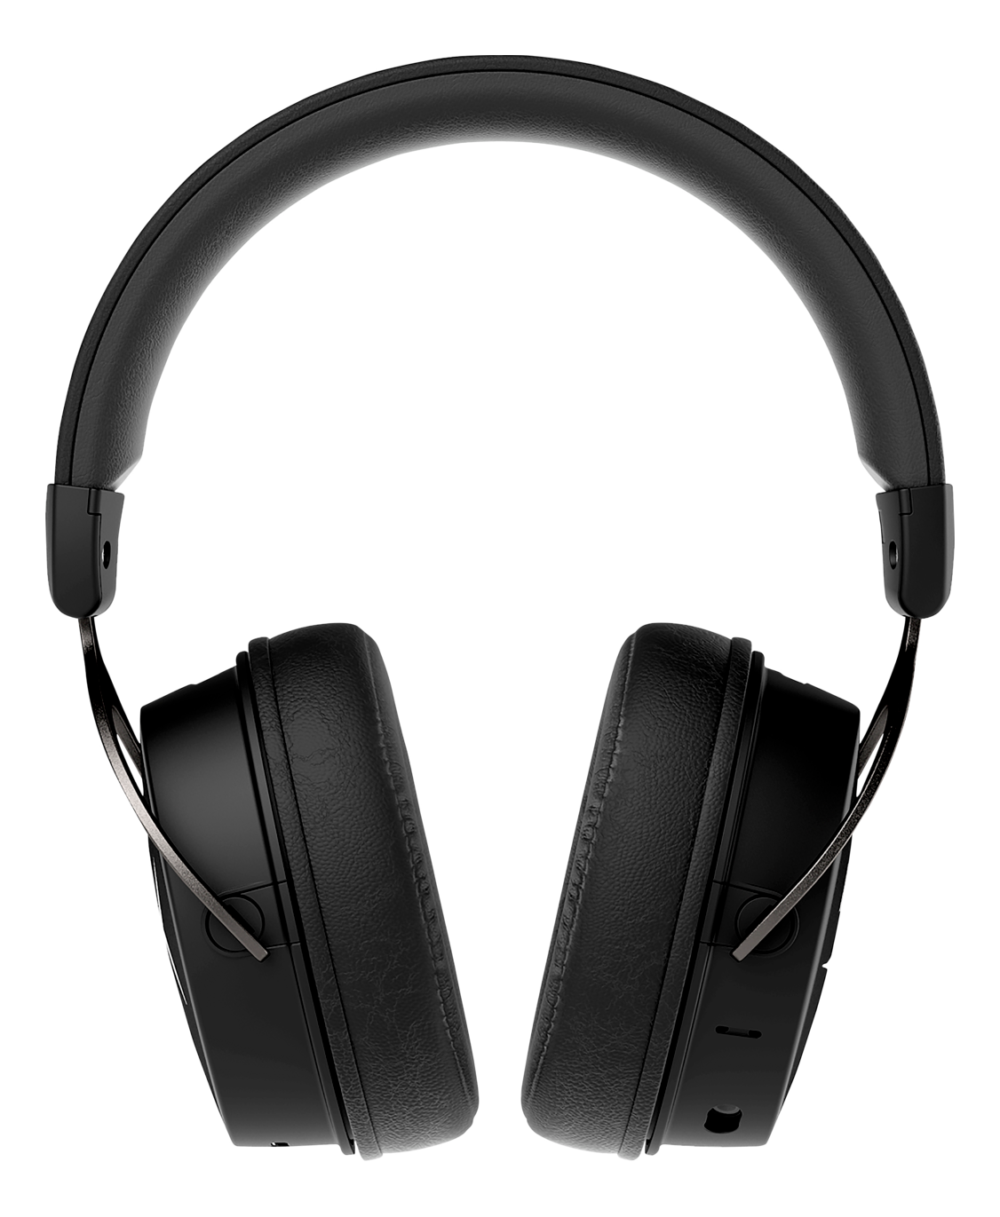
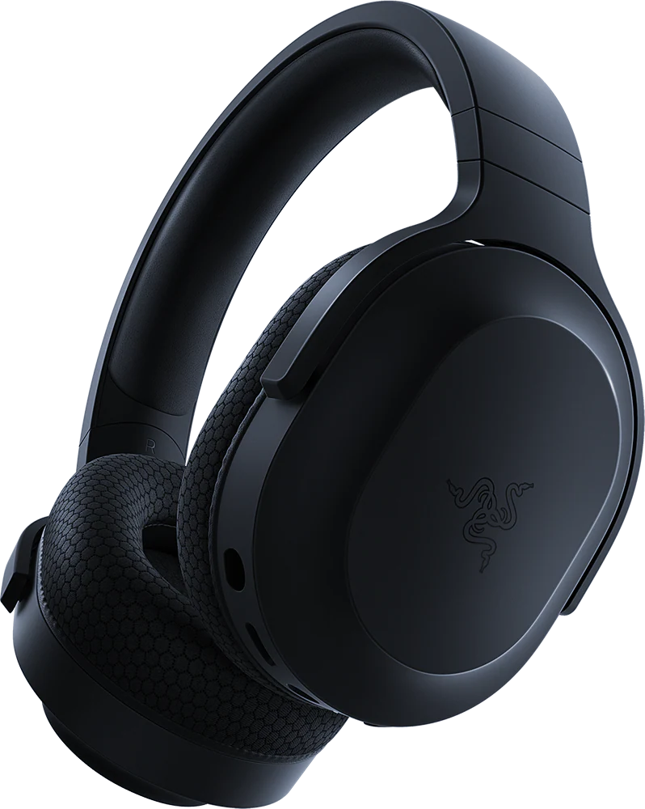
AQIRYS – Wireless Headsets
AQIRYS Lyra
LOGITECH G435
SteelSeries ARCTIS 3
RAZER Baracuda X
HyperX Cloud MIX
MSRP
69.99 €
79.99 €
129.99 €
119.99 €
199.99 €
Weight
260g
165g
316g
250g
258g
Sound
3D Stereo
Stereo
Stereo
Stereo
Stereo
Vibration effect
Yes
No
No
No
No
Backlight
Yes
No
No
No
No
Microphone
1 x built-in 1 x removable
Build-in
Retractable
Removable
1 x built-in 1 x removable
Dual Wireless
- USB receiver for Ultra-low latency
- Bluetooth 5
- USB receiver for Ultra-low latency
- Bluetooth 5
No
- USB receiver for Ultra-low latency
- Bluetooth 5
No
Battery Life
Up to 27h
Up to 18h
Up to 28h
Up to 50h
Up to 20h

Slide 17
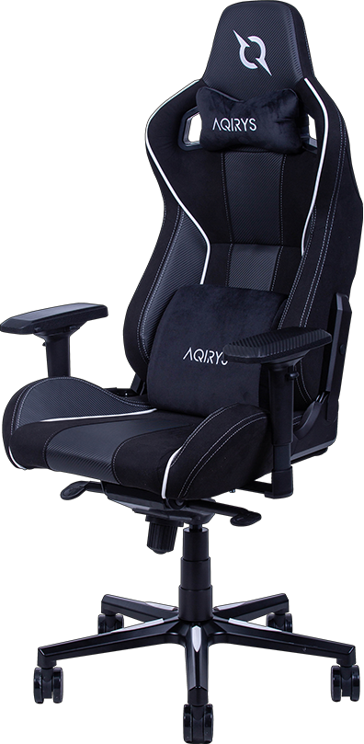
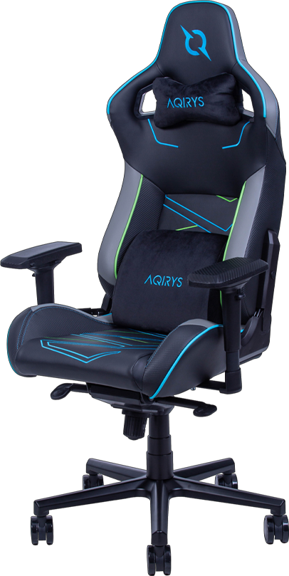
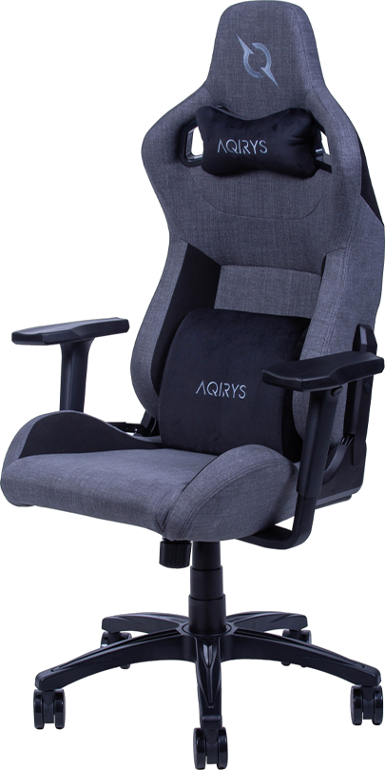
AQIRYS - Gaming Chair

Slide 18
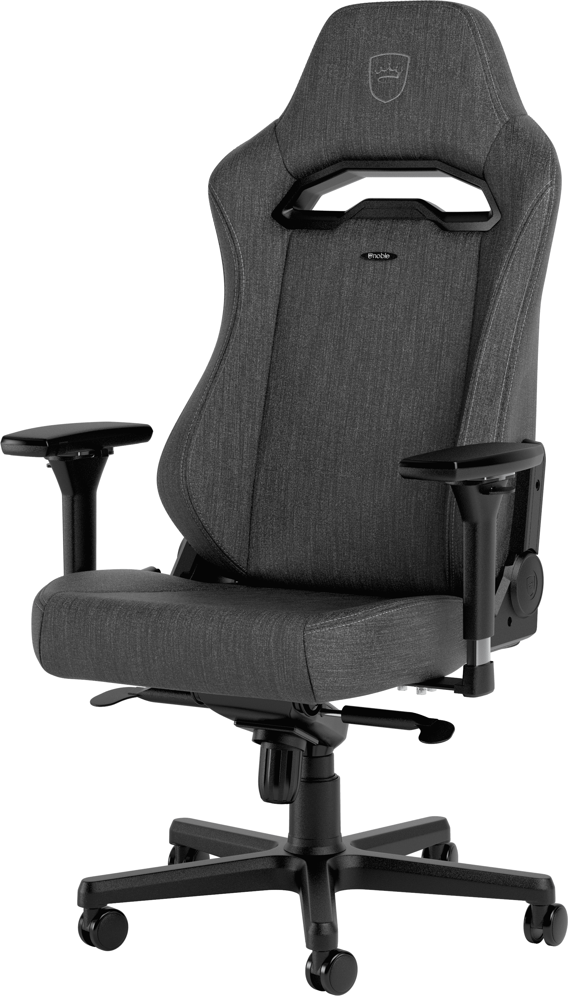
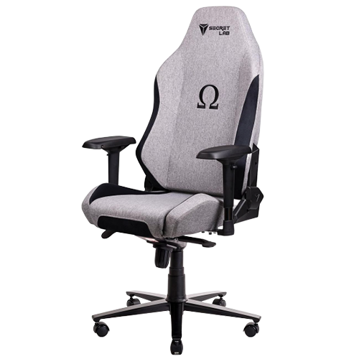
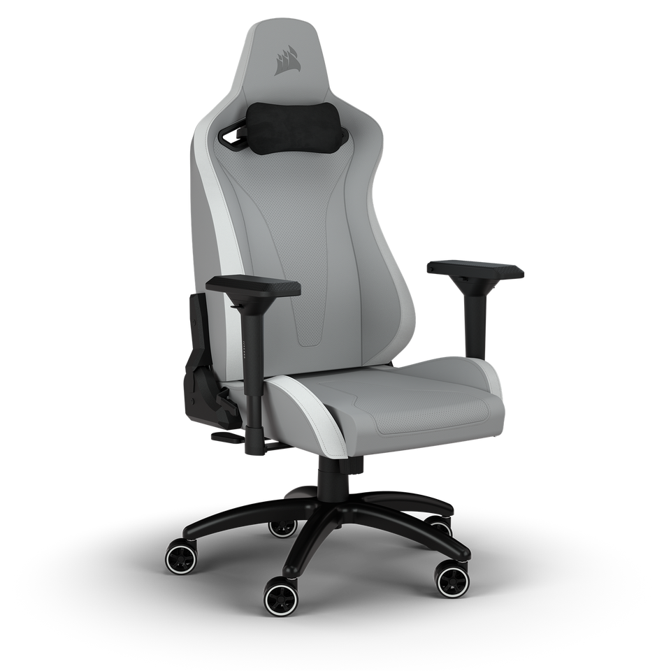
AQIRYS – Gaming Chairs
Secretlab OMEGA 2020
AQIRYS Ymir
NOBLECHAIR HERO TX
Corsair TC200
MSRP
379.99 €
419.99 €
449.99 €
389.99 €
Maximum Load
160 kg
150 kg
110 kg
120 kg
Lumbar support
Yes
Yes
Yes - optional
Yes
Cervical support
Yes
Yes
Yes
Yes
Casters
3-inch Nylon (5 pcs)
2.4-inch Nylon (5 pcs)
XL PU coated (5 pcs)
2.4-inch Nylon (5 pcs)
Frame Type
Carbon Steel
Robust steel
Steel
Steel
Upholstery Type
High-Quality Fabric
Fabric
Soft-Weave Fabric
Soft Fabric
Gas Piston
Class 4
Class 4
Class 4
Class 3
Mechanism
Frog
Frog
Frog
Butterfly
Certification
EN 1335-1:2021 & EN 1335-2:2019
DIN EN 1335
EN 1335-2:2019
No
Extra
3-inch Silent Wheels (5pcs)
No
No
No

Slide 19
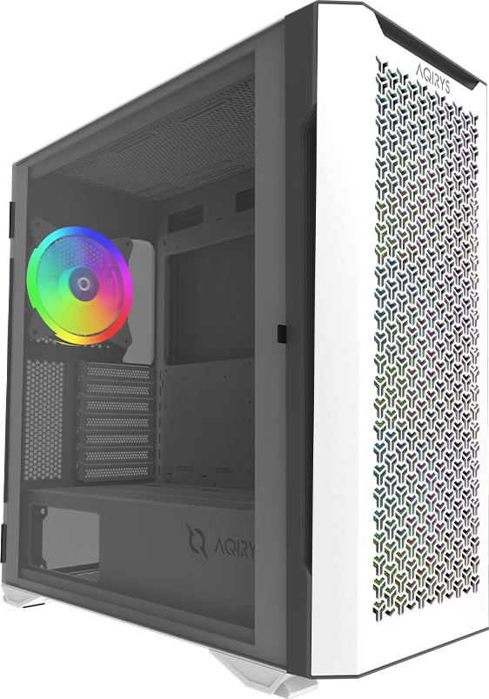
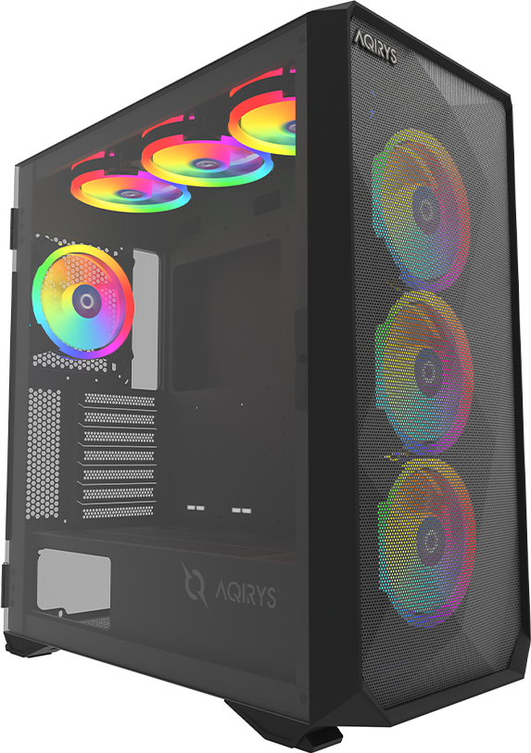
AQIRYS – PC Case

Slide 20
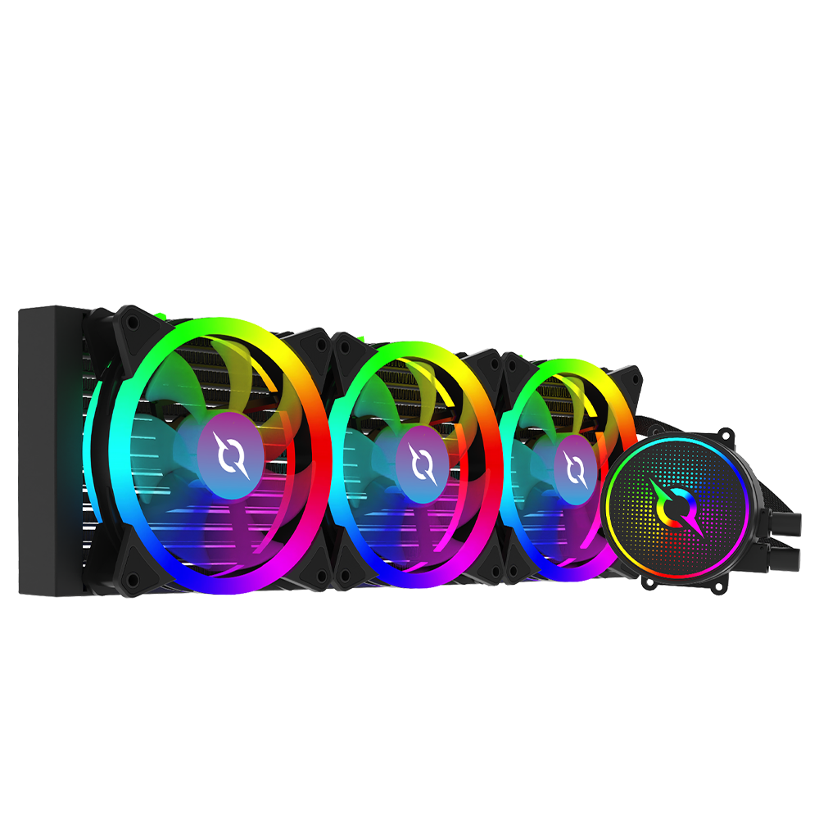
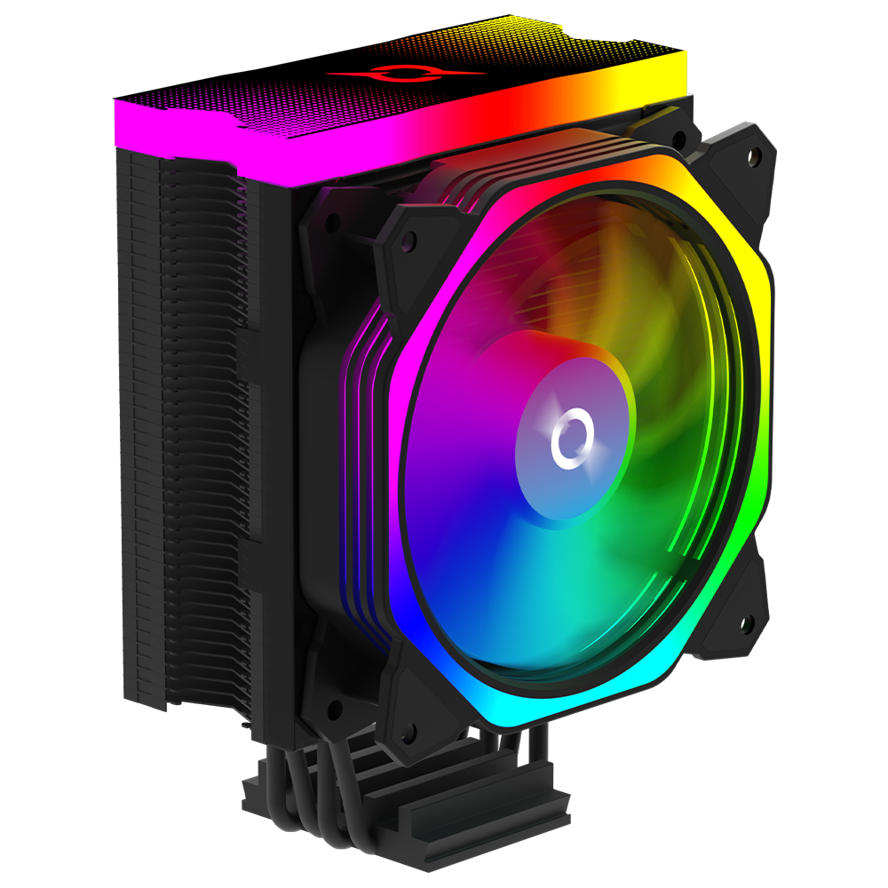
AQIRYS – CPU Coolers

Slide 21
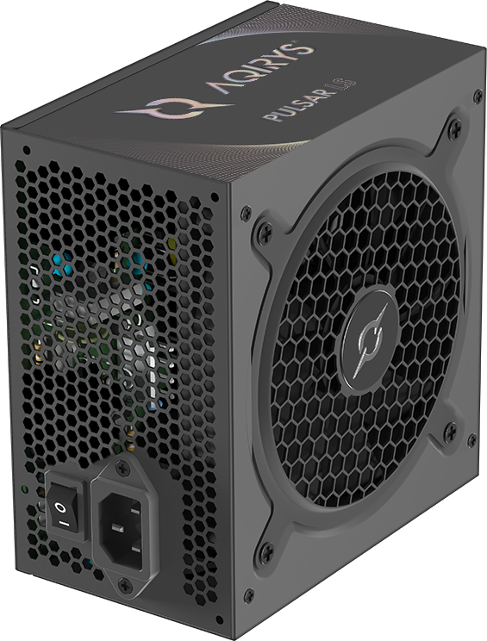
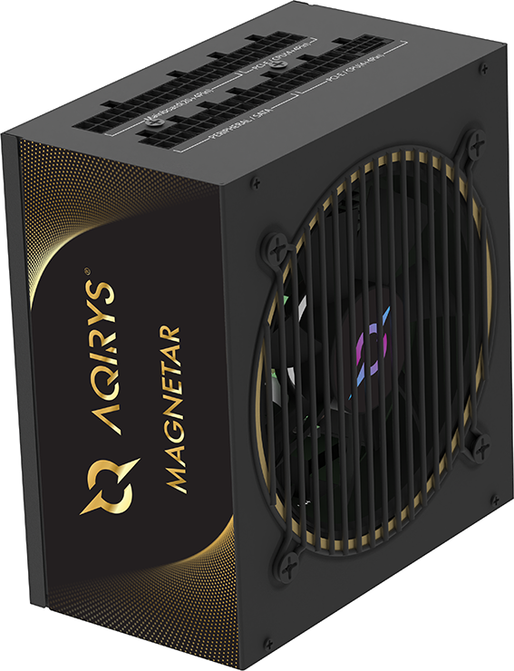
AQIRYS - PSU

Slide 22
Our Awards

